Slide 1

Presentation
By
Rohan Kumar
G. Sai Swagath
U. Sri Vatsalya
D. Priyanth

Slide 2
Outline
Introduction
Existing System
Proposed Scheme
Experimentation
Results
Conclusion
Bibliography

Slide 3
Introduction
Cloud computing, a critical pattern for advanced data service, has become a necessary feasibility for data users to outsource data.
The main threat on data privacy roots in the cloud itself.
Privacy issue is formulated from the aspect of similarity relevance and scheme robustness.
In cloud computing, data owners may share their outsourced data with a number of users.
Keyword-based retrieval is a typical data service by which users retrieve relevant ﬁles in a ﬁle set based on keywords.
The issue of secure multi-keyword top-k retrieval over encrypted cloud data thus is: how to make the cloud do more work during the process of retrieval without information leakage.

Slide 4

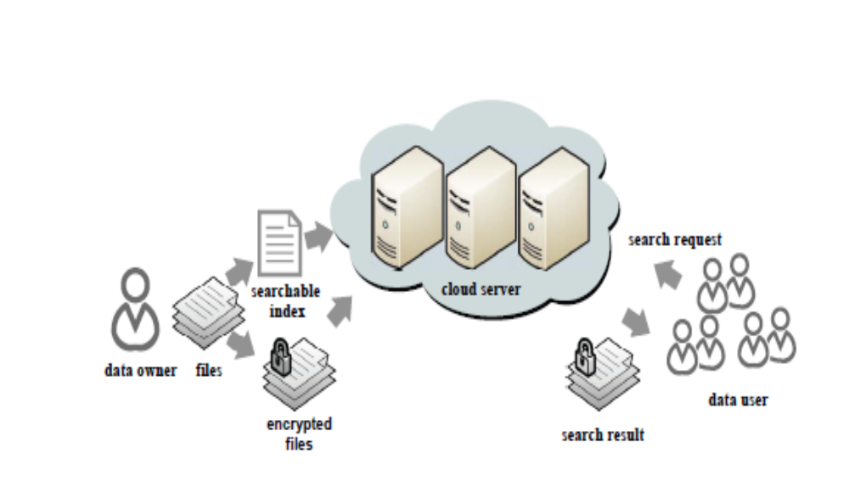
System Architecture

Slide 5
Existing System
A series of Searchable Symmetric Encryption(SSE) schemes have been proposed to enable search on cipher text.
Traditional SSE schemes enable users to securely retrieve the cipher text, but these schemes support only Boolean keyword search.
Facing a problem of how to strike a balance between data security and efficiency.
Disadvantages
These schemes, however, suffer from two problems – Boolean representation and how to strike a balance between security and efficiency.
Files are ranked only by the number of retrieved keywords, which impairs search accuracy.
Security is implicitly compromised to tradeoff for efficiency, which is particularly undesirable in security-oriented applications.

Slide 6
SSE Algorithm
Keygen(1k): outputs symmetric key K
BuildIndex(K, {D1, ...,Dn}):outputs secure index I
Trapdoor(K, w): outputs a trapdoor Tw
Search(I, Tw): outputs identifiers of documents containing w (id1, ..., idm)

Slide 7
SSE System Operation
Secure index: additional data structure that helps the server to search.
Symmetrically encrypted data: client performs encryption himself.
Trapdoors: associate a trapdoor to keywords which enables server to search while keeping keyword hidden.

Slide 8
Proposed system
Novel technologies in the cryptography community and information retrieval community are employed.
Majority of computing work is done on cloud while use takes part in ranking.
Two Round Searchable Encryption is used.
Advantages
With the concepts of similarity relevance and scheme robustness, the first attempt is made to formulate the privacy issue in searchable encryption.
TRSE scheme fulfills the secure multi-keyword top-k retrieval over encrypted cloud data.
Thorough analysis on security demonstrates the proposed scheme guarantees high data privacy.

Slide 9
TRSE Design
The data owner encrypts the searchable index with homomorphic encryption.
Next, the data user decrypts the scores and picks out the top-k highest-scoring files’ identifiers to request to the cloud server.
The retrieval takes a two-round communication between the cloud server and the data user.
Thus the name Two Round Searchable Encryption(TRSE).

Slide 10
Practical homomorphic Encryption scheme
Homomorphic encryption allows specific types of computations to be carried out on the corresponding cipher text.
Homomorphic encryption allows computation of cipher text without knowing anything about the plaintext to get the correct encrypted result.

Slide 11
Framework of TRSE
Setup(λ)
IndexBuild(C,PK)
TrapdoorGen(REQ, PK)
ScoreCalculate(T, I’)
Rank(R,SK,k)

Slide 12
Issues involved in TRSE
Efficiency Improvement: Improving the efficiency by reducing the cipher text size.
Enable Update: Since the calculation is on the server side and the computing power on the server side is high, the overall efficiency is almost immune to the update.

Slide 13
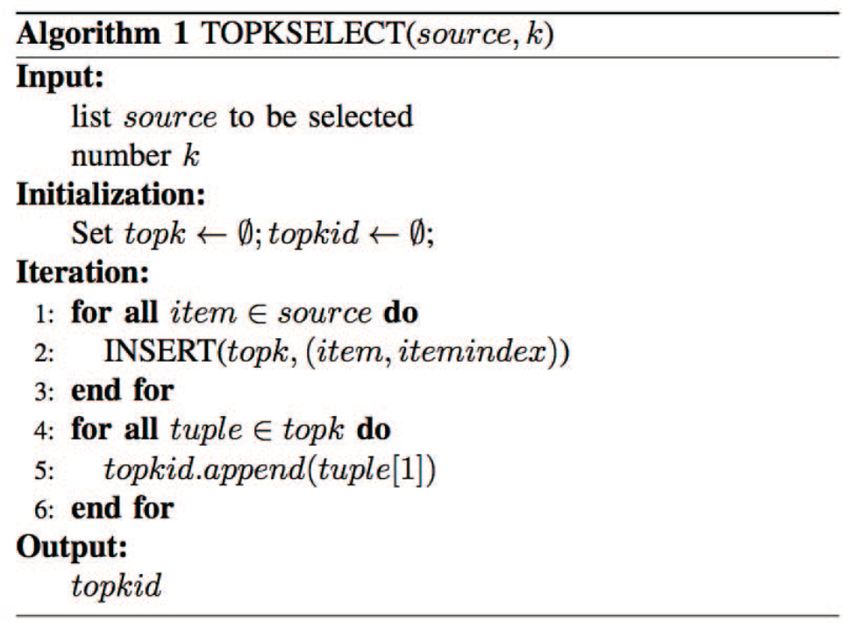
Proposed Top-k select Algorithm

Slide 14
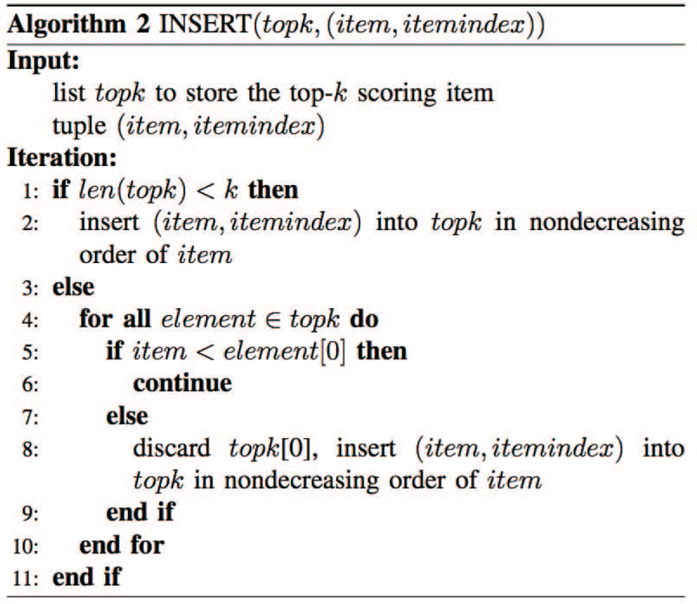
Proposed INSERT Algorithm

Slide 15
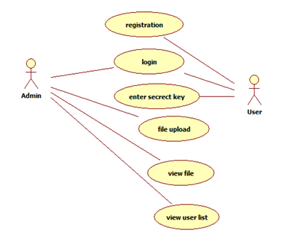
Design Analysis
UML Diagrams – Use Cases of System

Slide 16
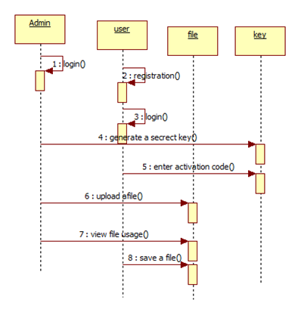
Sequence Diagram

Slide 17
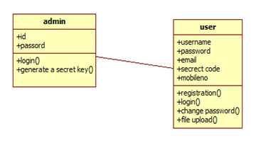
Class Diagram

Slide 18
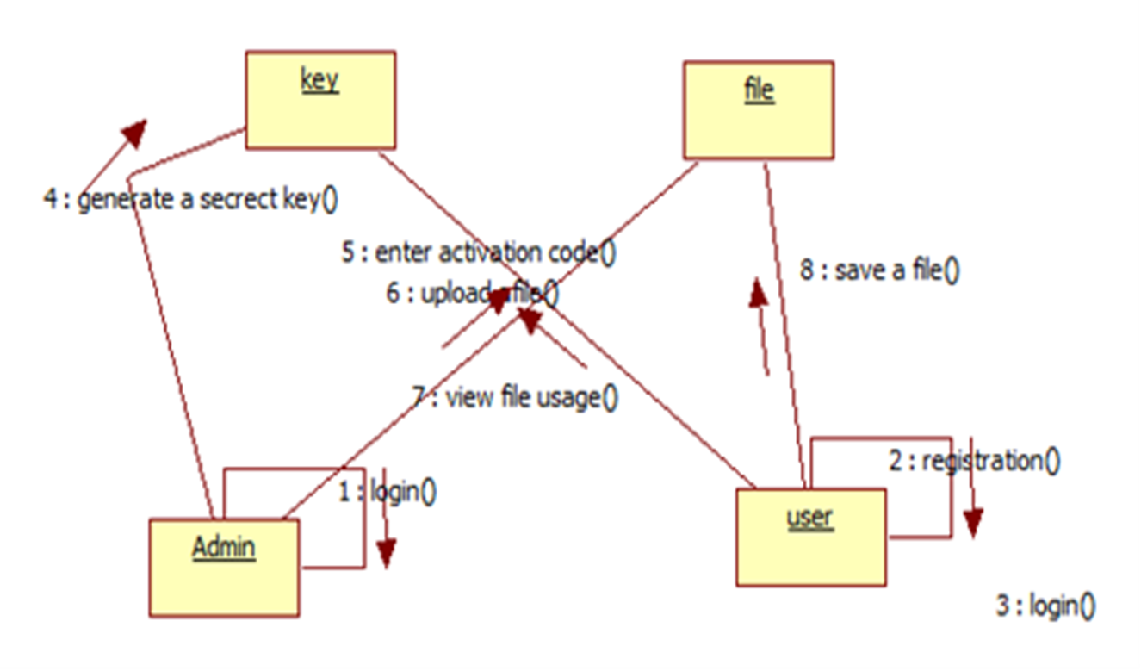
Collaboration Diagram

Slide 19
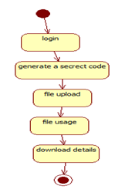
State Machine Diagram
Admin

Slide 20
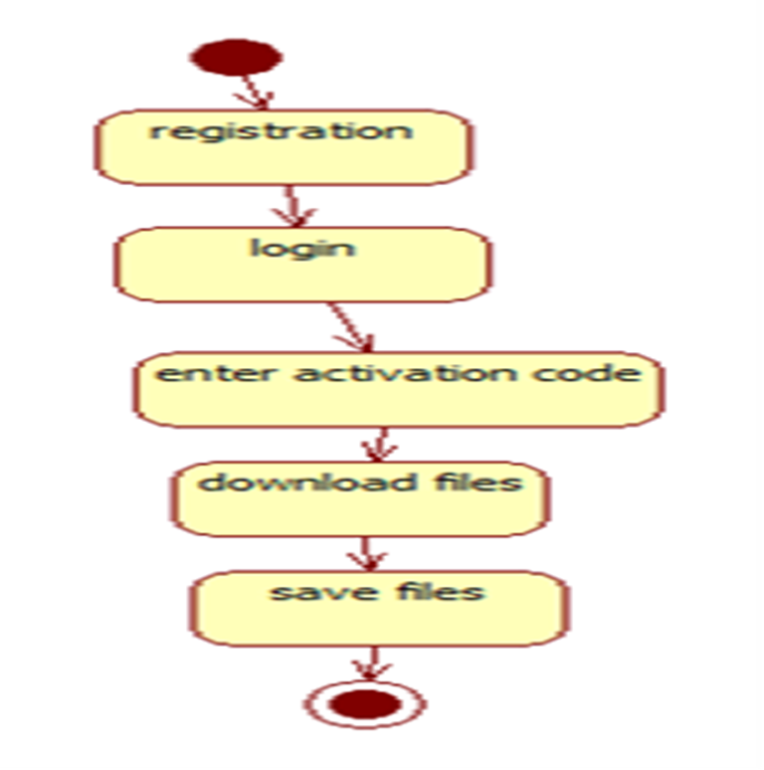
State Machine Diagram
User

Slide 21
Experimentation
Modules
Admin: An admin will first login to the further actions. Once logging in successfully he can view all the client details i.e., about his registration and his file details. Admin uploads the files and his responsibility is to send a files corresponding to the client request.
User: After his registration done he can successfully login, a client can know about his details, update his details, send request for a file and can get the files.

Slide 22
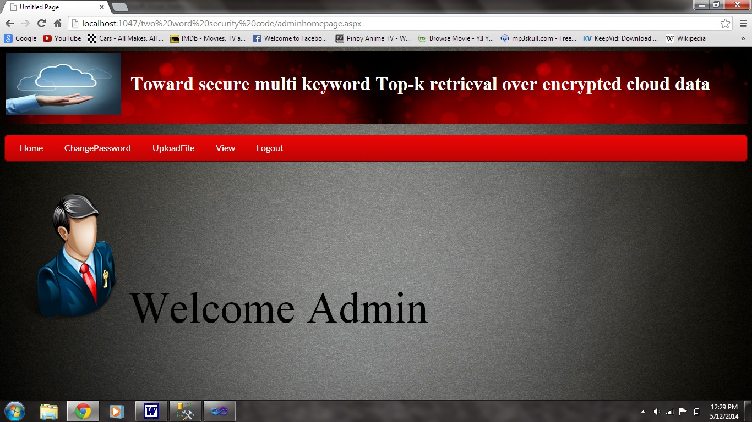
Admin Home Page

Slide 23
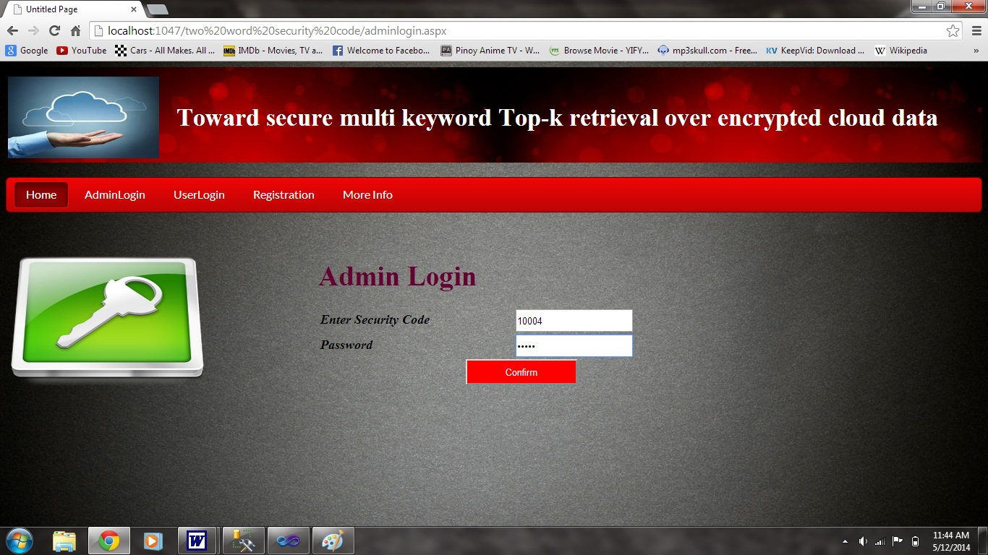
Admin Login

Slide 24
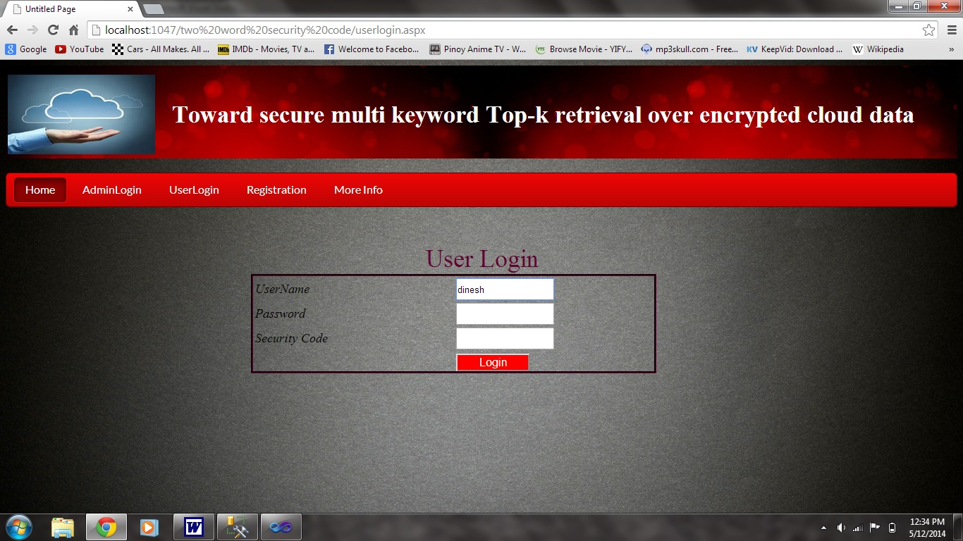
Password Window

Slide 25
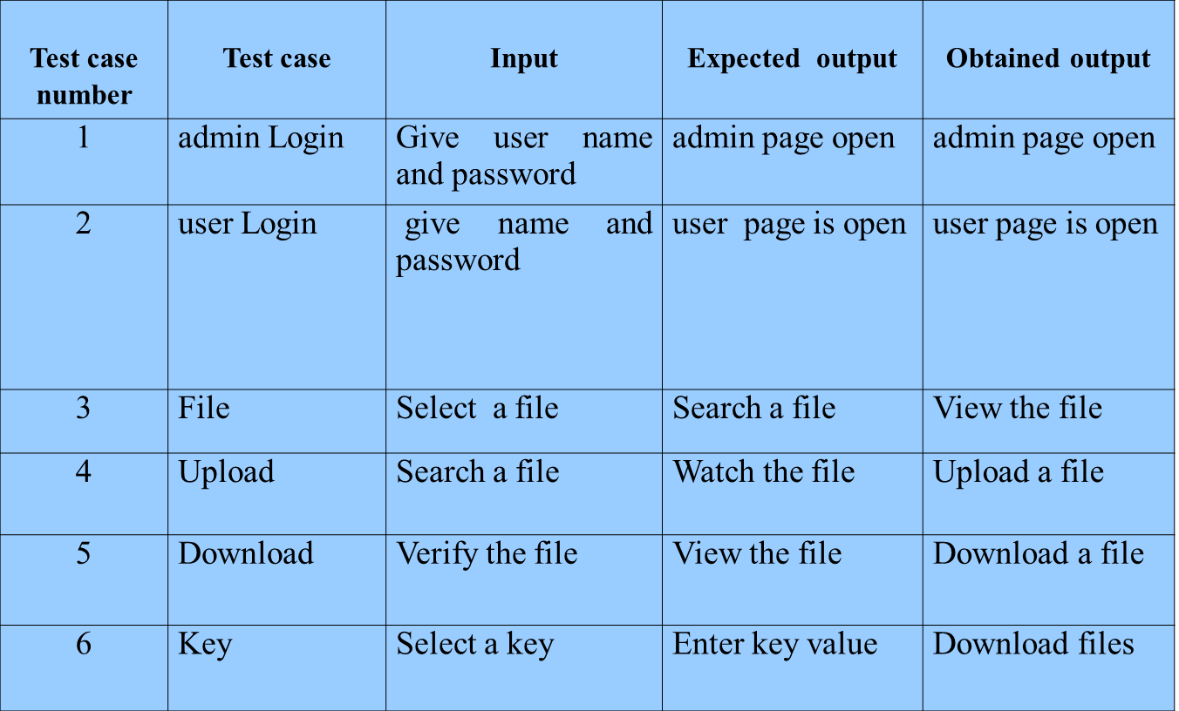
RESULTS

Slide 26
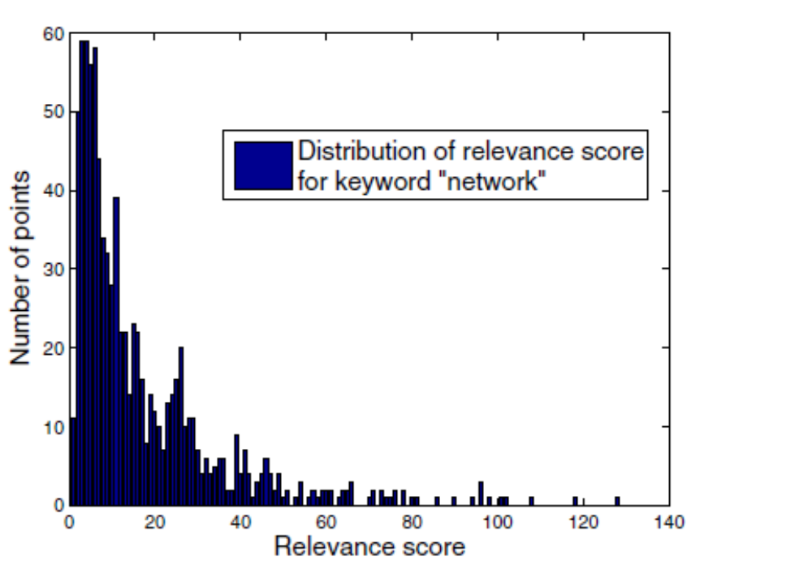
Graph showing Relevance Score

Slide 27
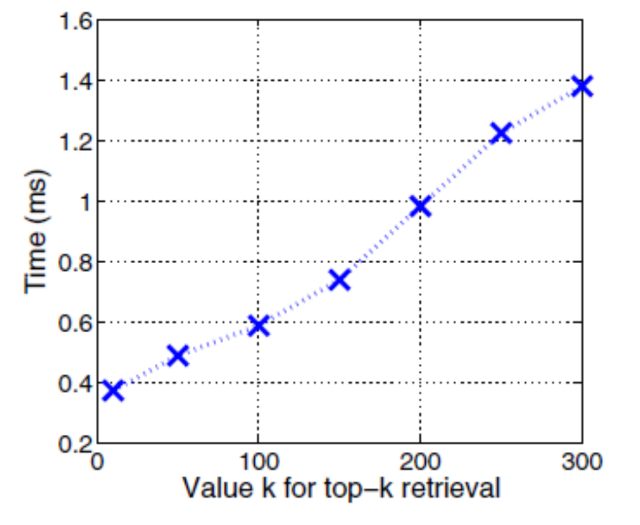
Time Cost for Top-k Retrieval

Slide 28
CONCLUSION
The problem of efficient ranked keyword search is solved.
Through security analysis, the proposed solution is secure and privacy-preserving.

Slide 29
BIBLIOGRAPHY
[1] A. Arasu and H. Garcia-Molina, “Extracting Structured Data from Web Pages,” Proc. SIGMOD Int’l Conf. Management of Data, 2003.
[2] L. Arlotta, V. Crescenzi, G. Mecca, and P. Merialdo, “Automatic Annotation of Data Extracted from Large Web Sites,” Proc. Sixth Int’l Workshop the Web and Databases (WebDB), 2003.
[3] P. Chan and S. Stolfo, “Experiments on Multistrategy Learning by Meta-Learning,” Proc. Second Int’l Conf. Information and Knowledge Management (CIKM), 1993.
[4] W. Bruce Croft, “Combining Approaches for Information Retrieval,” Advances in Information Retrieval: Recent Research from the Center for Intelligent Information Retrieval, Kluwer Academic, 2000.
[5] V. Crescenzi, G. Mecca, and P. Merialdo, “RoadRUNNER: Towards Automatic Data Extraction from Large Web Sites,” Proc. Very Large Data Bases (VLDB) Conf., 2001.

Slide 30
Thank You

